Slide 1
What is 3D??
3d is the new technology introduced in the television world. It helps the viewer to see the world beyond imagination.
It makes the pictures so realistic, making the viewer feel that things are happening around him.

Slide 2
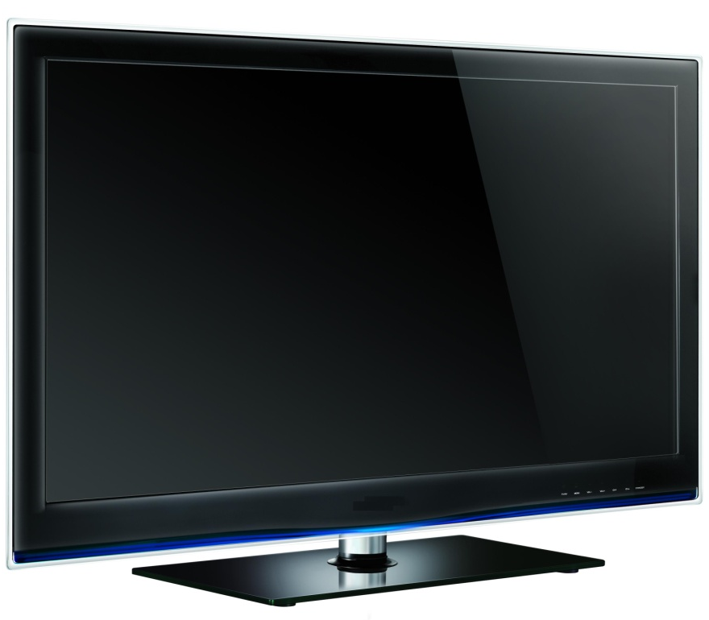
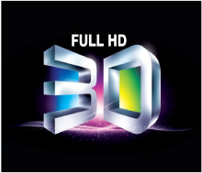
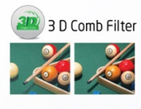
V55563DZ - 3D LEDTV
Features :
55” FHD LED TV
3D TV (Active Shutter Glass)
240Hz Refresh Rate
Real 3D (HDMI/USB)
10 Bit Video Processor
Front Panel Touch Controls
4 HDMI
Deep Color, xvYCC
OPC (Optimum Power Consumption)
2 USB – 1080p Video Support
5 Band Equalizer
Eco Panel
Low Power Consumption

Slide 3
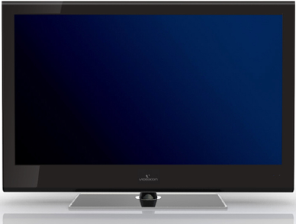
V32550PB - 3D LEDTV
Features :
32” FHD LED TV
3D TV (Flicker Free)
Real 3D (HDMI/USB)
2D to 3D Conversion
10 Bit Video Processor
Front Panel Touch Controls
3 HDMI
Deep Color, xvYCC
USB – 1080p Video Support
5 Band Equalizer
Eco Panel
Low Power Consumption

Slide 4
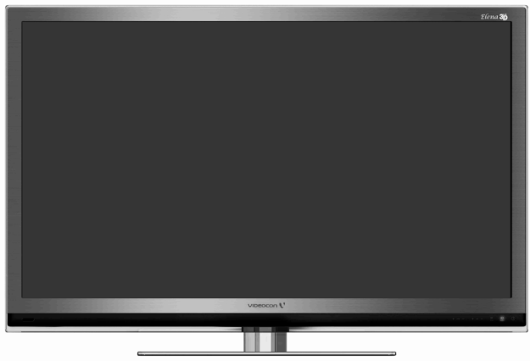
V55591PZ - 3D LEDTV
Features :
55” FHD LED TV
3D TV (Flicker Free)
Real 3D (HDMI/USB)
2D to 3D Conversion
120Hz Refresh Rate
10 Bit Video Processor
Front Panel Touch Controls
2 HDMI
Deep Color, xvYCC
2 USB – 1080p Video Support
5 Band Equalizer
Eco Panel
Low Power Consumption

Slide 5
Videocon 3D Model Matrix
Model no. | LEDTVV55563DZ | LEDVV32550PB | LEDTVV55591PZ
Screen size | 55” LEDTV | 32”LEDTV | 55” LEDTV
3D Technology | Active shutter | Pattern retarded (Flicker Free) | Pattern retarded (Flicker Free)
3D Goggles | 3 Goggle | 4 goggle | 4Goggle + 4(Split)
Power for goggle | Replaceable Batteries | NA | NA
3D Source | HDMI | HDMI | HDMI
 | MULTIMEDIA | MULTIMEDIA | MULTIMEDIA
Supported 3D Formats | Side by side | Side by side | Side by side
 | Top to bottom | Top to bottom | Top to bottom
 |  |  | H Interlace
 |  |  | Flipping
2D to 3D Conversion | No | Yes (Except in VGA) | Yes (Except in VGA)
3D Contents with TV | 2GB USB with 3D Contents | No | B.D.Player

Slide 6
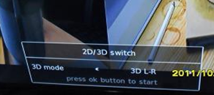
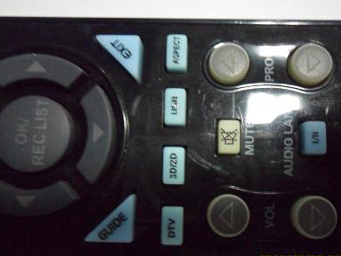
Process to set 3D mode ON
LEDTVV55563DZ: In HDMI /Multimedia source press 2D-3D key on remote & Select 3D format as per input (Refer table A for details)

Slide 7
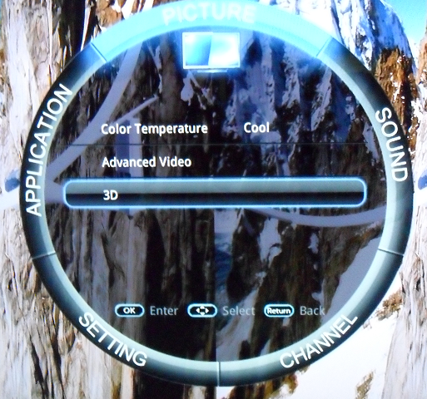
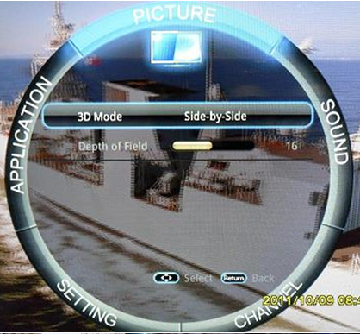
LEDTVV32550PB: Press menu key select 3D option & Select 3D format as per input (Refer table A for details)

Slide 8
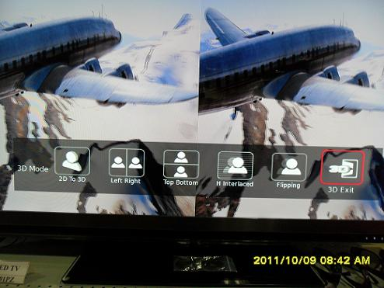
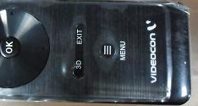
LEDTVV55591PZ: Press m 3D on remote & Select 3D format as per below table A

Slide 9
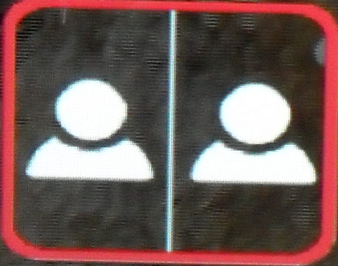
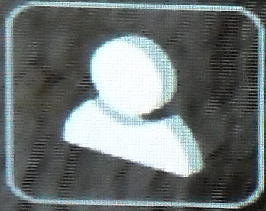
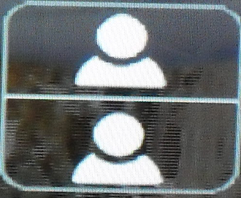
Table A
Video Display when 3D setting is Off | Required 3D Selection
3D Setting is “Off” | 3D setting “Side by Side”
3D Setting is “Off” | 3D Setting “Top to Bottom”

Slide 10
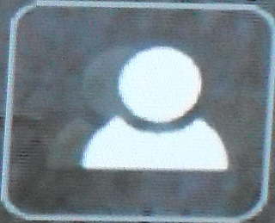
Table A
Video Display when 3D setting is Off | Required 3D Selection
3D Setting is “Off” | 3D setting “H Interlace”
3D Setting is “Off” | 3D Setting “Flipping”

Slide 11
FAQ for 3D
Optimum Distance for 3D Viewing?
Ans: Customer should sit 2 times diagonal screen size in front of TV (i.e. for 110” for 55” Model & 64” for 32” Model keeping set height at eyelevel )
What Should be wall mounting height?
Ans: For best 3D experience after wall mounting TV Should be at eye level from viewing position at customers place
In USB/HDMI, 3D effect is not there?
Ans : 1. Confirm file format/Resolution is as per model support list
2. You had selected correct 3D format under 3D setting options
3. If its ASG model then insure goggles are switched ON keeping it in front of TV
4. There should not be any obstacle in between TV & 3D goggle
5. Goggle Batteries are not discharged
6. Insure room lighting is not interfering with 3D goggles (Switch OFF room light)
7.Check effect with demo content provided with TV Set or With “Legends of Flight “Video

Slide 12
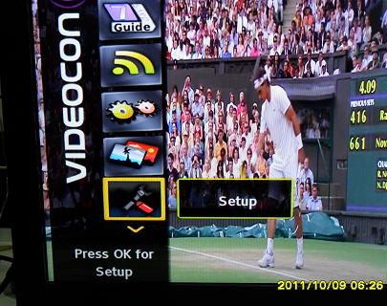
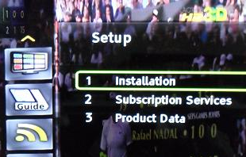
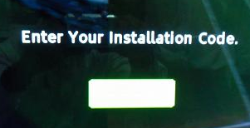
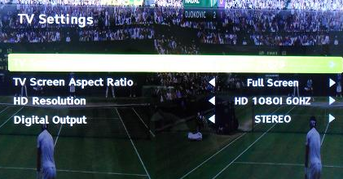
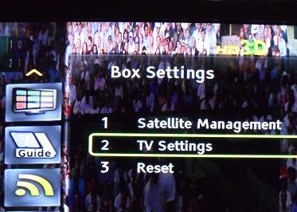
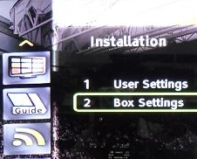
Flickering is observed with Videocon 3D STB?
Ans: In Setup menu of STB change resolution to 1080i 60Hz as per below steps
Press STB Menu key
Go to Setup option
Go to Installation option
Enter Password as “1234”
Set resolution as 1080i@60Hz
Select TV settings
Select Box settings

Slide 13
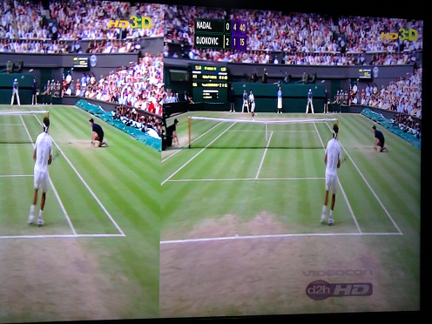
In 2D to 3D mode depth is less or ghost is observed around characters?
Ans: Adjust 3D depth in 3D menu to get 3D depth or avoid ghost effect around Characters
Videocon Logo in HD generator /3D STB is looking abnormal in 3D mode
Ans: Videocon Logo is not 3D transmission but 2D hence it cause stress while watching
To avoid this disable it through HD Generator or STB setup menu
3D Logo
2D Logo

